Slide 1


Churner
Analysis
Swan Teleco

Slide 2
Data and Deck Overview
CA, US
Q
73.5%
26.5%
Data gathered from customers in California, United States of America
Data provided is single customer view over the last quarter
The % of non-churn customers
The % of churn customers
Four questions to answer:
When? | Why? | Who? | What do?

Slide 3


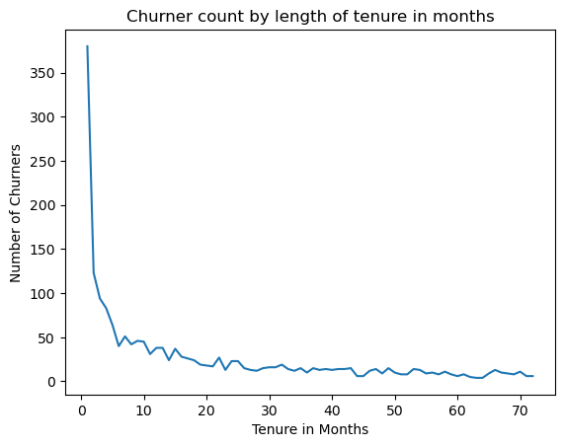
When customers churn?
Highest churn:
20% of churners leave in Month 1
Steady churn:
From month 6 drops below 3%
Critical months:
Months 1 to 5 incl. 39% of churners leave in the first 5 months

Slide 4


33% Competitor: Offers, devices, speed, data
Why customers
churn?
29% Customer Experience: Attitude, lack of expertise, service dissatisfaction
13% Product:
Range of services, reliability, product dissatisfaction
Based on the reasons provided by the customers who have churned
13% Price:
Extra data charges, affordability
11% Other:
Unknown or not under the company’s control

Slide 5






Demographics:
Under the age of 65
Single
No dependents
Churner Profile
Meet Ms/Mr Churner
Customer set-up:
Month-to-month contract
Paperless billing
Payment by electronic check
Gender is not a factor, split between male/female is even
Products/Services:
Phone service
Fibre optic internet service
Streaming movies and TV

Slide 6

Churning Factors
Contract Type
Stay or go?
Monthly Charges
Contract Type
88% of churners are on a month-to-month contract
Tenure Months
Monthly Charges
Average monthly charges for churners are ~$10 more
Tenure Months
Longer tenure lessens the likelihood of churning
Payment Method
Payment Method
Automatic payments preferred by half of non-churn customers
Streaming
Streaming
Issues with streaming services is a significant factor for churning

Slide 7

Month-to-month contracts make up 88% of contracts amongst churners. Compared to 33% in retained customers.
The factor to incentivise at customer sign-up in order to decrease the number of churners is Contract Type.
Incentivise: Contract Type

Slide 8


Thank you!
Connect with us.
Email
hello@datacygnets.com
Social Media
@datacygnets
Call us
1234-567890

